Slide 1
Mobile Marketing for Brands An Innovative Approach Capturing Opinions & Intent The fun, free & easy way!
ZipDial 022-3301-0050

Slide 2
ZipDial – Missed Call To Action!

Slide 3
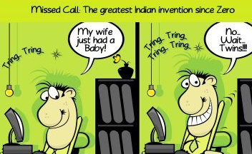
Founding Team Passion, Expertise & Experience
Valerie Rozycki, CEO
Amiya Pathak, COO/CTO
Passionate Entrepreneur
mChek, eBay (US)
Stanford BS/MS(Public Policy)
Top 3 finalist in Bloomberg Pitch
Charter Member of GSMA’s mobile for women steering group
IIT-K Computer Science, IIM-C
12 years in industry
Zapak.com, Ketera, i2, Mindtree
Excellent team builder
Strong techno-business guy
Sanjay Swamy, Chairman
The Inspiration!
Strategy/Ideator @ ZipDial
Former CEO of mChek
Setup Ketera & mPortal India
14 years in Silicon Valley
Actively guiding team

Slide 4
Some of what ZipDial Enables
2-way info update
Flash ‘Opinion’ Polling
News, policies, elections
Weather patterns, diseases
Crop news, scores
Citizen Journalism Quantified
Real-time opinions - instantly
Demographic-based sorting
Sample and tweak messaging
Targeted mobile panels
Event Participation
Inclusive Elections
Announcements with RSVP
Effectiveness measure
Pre-meeting opinion
Post-meeting opinion
Making events fun/interactive
Registered Users May Vote
Reduces Polling booth load
ZERO income loss to voters
Secret ballot ensured with banking-grade security

Slide 5
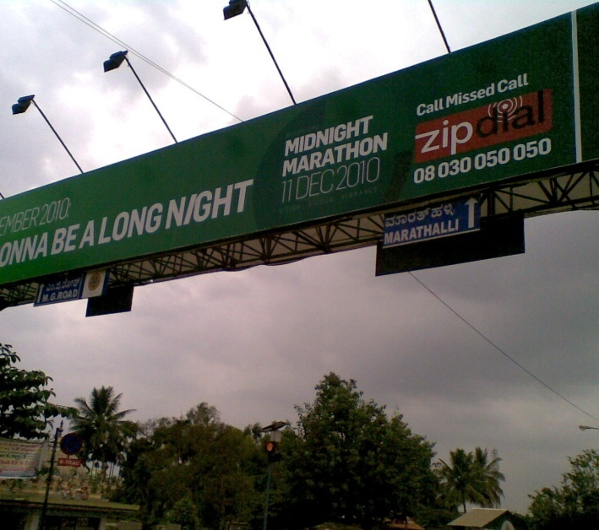
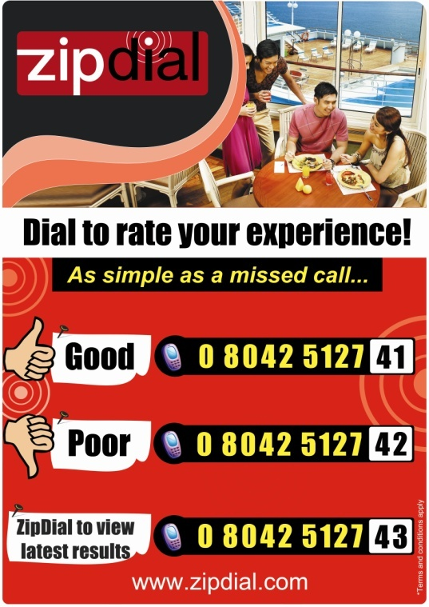
ZipDial can be used in any media
Media Formats
Print & Television
Billboards, SMS, Internet
Mailers/Feedback forms
Social media
Blogs
Live events
Local languages

Slide 6
ZipDial BloombergUTV Survey for Mobile # Portability

Slide 7
ZipDial user survey conducted for last 2 hours of an India-NZ match
~2000 users answered all 11 questions in 2 hours!!!
Interesting takeaways
37% Villages
14% Metros
49% Tier 2/3
22% Female
28% Spend the day @ home
10% Travel abroad
22% Travel in India
51% Student
62% on Nokia
17% Work
10% Travel abroad
22% Travel in India
51% Student
62% on Nokia
17% Work

Slide 8
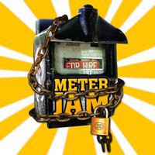
Try ZipDial Live Today!
Free Cricket Scores – Anytime, Anywhere, and from Any Mobile
Pledge to Support
Grass Roots
Movements
080 300 500 15
Engagement for Mass Market branding campaigns – 1 800 200 9944
Notes:
Examples of how ZipDial is being used today

Slide 9
Simple pricing, Scalable, Self-Service Target: 100,000 ZipDial Numbers in 4 years - $25M per year in Revenue
Simple pricing model
Self-service portal
Rs. 1000/mo/ZipDial#
1000 free SMS’s included
Additional ZipDials @ 0.5
Create messages/polls online
Analyze results in real-time
Download/integrate results
Key focus areas
Free cricket scores – a branding and customer, data acquisition strategy
Ideally we would like to make this cost neutral with some advertising
Auto-Response - Customer publishes a ZipDial number on every shop/clinic, etc.
Users can get ZipDial and get Hours of Operation, Deals, etc.
Lead Generation – Send response, and Post lead to CRM
Privacy of user is protected by ZipDial
Polling – for market research, political party opinions etc.
Transactions – link to Facebook, Twitter, Mobile Banking, etc.
ZipDial - AppStore – allowing 3rd parties to build applications on ZipDial platform

Slide 10
Thank You!
Questions?
info@zipdial.com
Valerie Rozycki
valerie@zipdial.com
Amiya Pathak
amiya@zipdial.com
Sanjay Swamy
sanjay@zipdial.com

